Slide 1
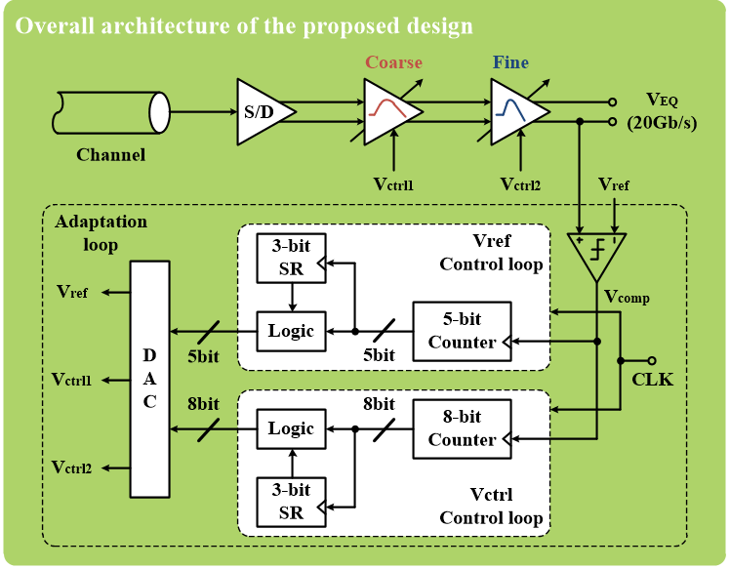
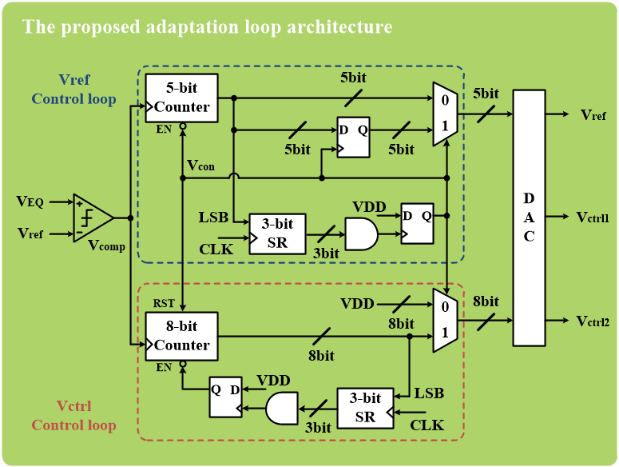
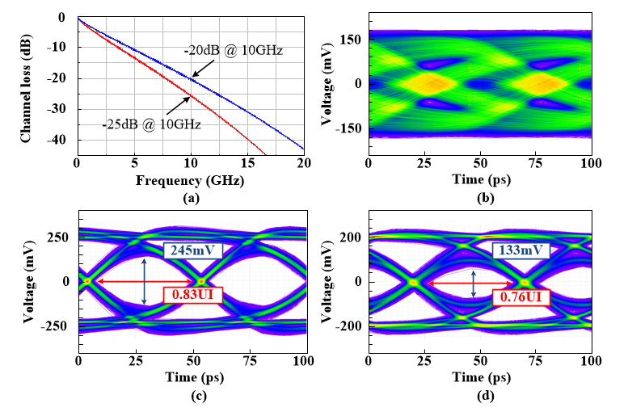
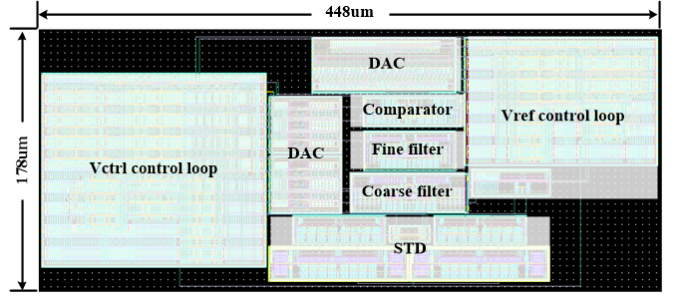
A 0.79-pJ/bit 20-Gb/s Adaptive Coarse/Fine Linear Equalizer with 25dB loss for Single-ended Interfaces in 65nm CMOS
Jongchan An, and Junyoung Song*
Department of Electronics Engineering, Incheon National University
Background
As the single-ended interfaces for mobile applications such as smart-phone and tablet PCs are grown, the mobile DRAMs require higher data rates and energy efficiency
As the data rate per pin increases in the single-ended transceiver, the bandwidth limitation becomes more severe
Consequently, the signal is significantly distorted due to the channel bandwidth limitation
Several adaptive linear equalizers have been proposed to compensate for distorted signals
However, the adaptation using one or cascade the same linear equalizer results in poor fine control of the equalizer gain
To overcome this issue, the proposed adaptation uses two linear equalizers with different boosting ranges and control voltages
Proposed Design & Results
Fig 1. Top architecture of proposed design
Fig 2. Adaptation loop architecture of proposed design
Fig 3. Simulation results
Fig 4. Layout of the proposed design
Conclusion
The digitally adaptive coarse/fine linear equalizer is proposed in 65nm CMOS technology for single-ended interfaces
The proposed adaptation achieves optimal-boosting by increasing the control voltage sequentially from over-boosting and this design is implemented by cascading equalizers with different boosting ranges and control voltages for high accuracy
Even though fabricated chip didn’t properly worked, the maximum eye-opening of the proposed adaptive coarse/fine linear equalizer is 0.83UI, and power efficiency is 0.79-pJ/bit at 20-Gb/s

